Slide 1
ICT Project Management

Slide 2
Project Objectives and Goals
SMART refers to criteria for setting goals and objectives, namely that these goals are: Specific, Measurable, Attainable, Relevant, and Time-bound.
Specific: The goal should target a specific area of improvement or answer a specific need.
Measurable: The goal must be quantifiable, or at least allow for measurable progress.
Attainable: The goal should be realistic, based on available resources and existing constraints.
Relevant: The goal should align with other business objectives to be considered worthwhile.
Time-bound: The goal must have a deadline or defined end.

Slide 3
Classification of Projects
Customer Specific New Development Project(CUST)
Is a project to create completely new customer specific software.
Software Product New Development Project(PROD)
Is a project to create a new software product. A software product is always developed to be used by more than one customer. A software product may be either standalone packaged software or embedded part of any other product.
Software Version Enhancement Project(VERS)
Is a project to create a new version of existing software. The existing software may be either customer specific software or a software product.

Slide 4
Classification of Projects (contd…)
ICT Service Development Project(SERV)
Is a project to create a contract-based continuous or temporary ICT service. The service may be, for example, either software or hardware related, and consists of maintenance, support, help desk, or operating service.
Package Software Configuration Project(PACK)
Is a project where the result is an installed, parameterized and, user configured software package.
Data Conversion Project(CONV)
Is a project where data is moved from persistent data storage of one information system to persistent data storage of another information system. The software developed in a data conversion project is often “throw away” in that it is only used once. Even so, the pieces of conversion software may reside on one or more hardware platforms.
Software Integration Development Project(INTG)
Is a project to create software that provides interfaces services between two or more information systems.

Slide 5
Project Environment
Internal Environments
External Environments

Slide 6
Interested Parties (or Stakeholders)
People or groups
interested in the performance and/or success of the project
affected or constrained by the project
Project Manager
identify the parties, their interests, and sequence both in order of importance to the project
Influence the project directly or indirectly
interested parties interests
project management practices
organizational project management maturity
standards, issues, trends

Slide 7
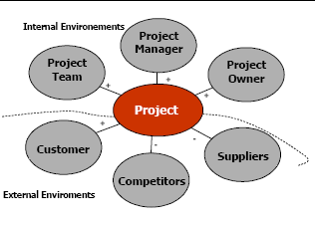
Interested Parties (or Stakeholders)
Project Sponsor
Project Manager
Project team
Project organization
Programme organization
Regional, national and international legislative and regulatory agencies
Users, Customers, …..
Suppliers
Community or special interest groups
Politicians…..

Slide 8
Program and Project Portfolio Management
A program is “a group of related projects managed in a coordinated way to obtain benefits and control not available from managing them individually” (PMBOK® Guide, Fifth Edition, 2013)
A computer program is a collection of instructions that performs a specific task when executed by a computer.
A program manager provides leadership and direction for the project managers heading the projects within the program
Examples of common programs in the IT field include infrastructure, applications development, and user support

Slide 9
Project portfolio
A set of project proposals, projects, programs, sub-portfolios and operations managed together to achieve an organisation's strategic objectives.
For instance, a company in the energy sector might have as business objective to "reduce carbon emissions". This portfolio could include sub-portfolios such as "improving efficiency of solar energy production" or projects such as "streamlining transport routes".

Slide 10
Project Portfolio Management
Project Portfolio Management is a senior leadership discipline that drives strategic execution and maximizes business value delivery through the selection, optimization, and oversight of project investments which align to business goals and strategies.
As part of project portfolio management, organizations group and manage projects and programs as a portfolio of investments that contribute to the entire enterprise’s success
Portfolio managers help their organizations make wise investment decisions by helping to select and analyze projects from a strategic perspective

Slide 11
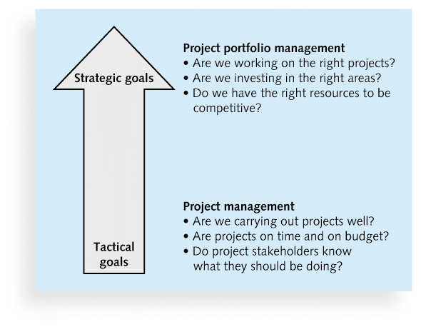
Project Management Compared to Project Portfolio Management

Slide 12
Best Practice
A best practice is “an optimal way recognized by industry to achieve a stated goal or objective”*
Robert Butrick suggests that organizations need to follow basic principles of project management, including these two mention:
Make sure your projects are driven by your strategy.
Be able to demonstrate how each project you undertake fits your business strategy, and screen out unwanted projects as soon as possible
Engage your stakeholders.
Ignoring stakeholders often leads to project failure.
Be sure to engage stakeholders at all stages of a project, and encourage teamwork and commitment at all times

Slide 13
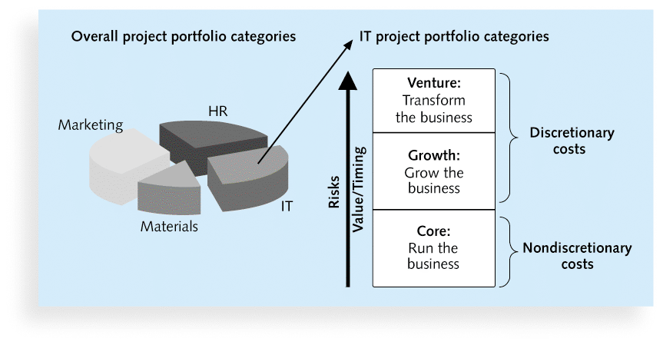
Sample Project Portfolio Approach

Slide 14
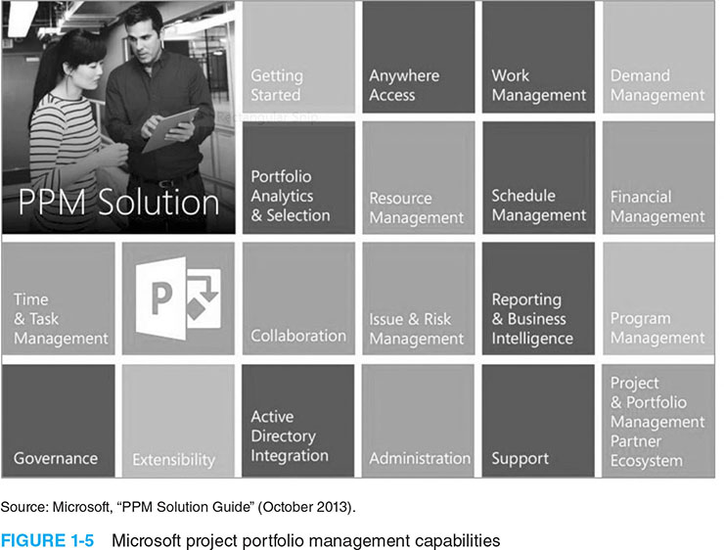
Microsoft project portfolio management capabilities

Slide 15

Project Team

Slide 16
High-Performing Teams
the interaction or cooperation of two or more organizations, substances, or other agents to produce a combined effect greater than the sum of their separate effects. Eg. "the synergy between artist and record company"
‘Synergy
1 + 1 = 3 (positive synergy)
1 + 1 = 1.5 (negative synergy)
Characteristics of High-performing Teams
Share a sense of common purpose
Make effective use of individual talents and expertise
Have balanced and shared roles
Maintain a problem solving focus
Accept differences of opinion and expression
Encourage risk taking and creativity
Sets high personal performance standards
Identify with the team

Slide 17
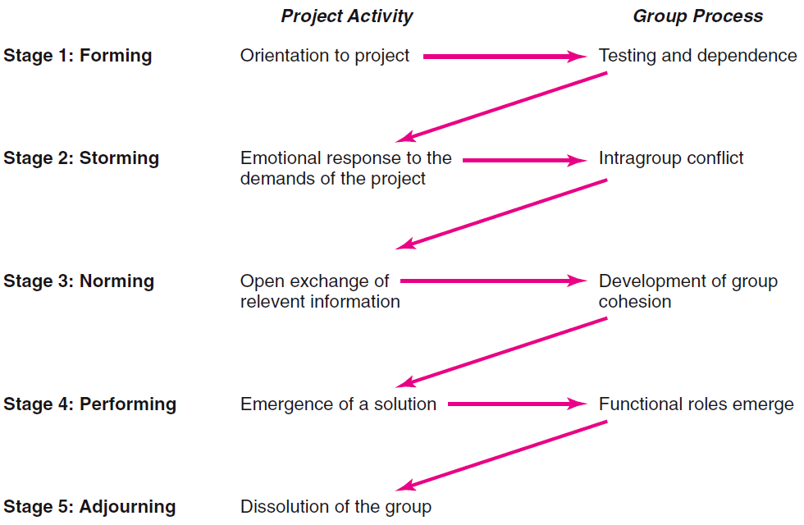
The Five-Stage Team Development Model

Slide 18
Conditions Favoring Development of High Performance Project Teams
Ten or fewer team members
Voluntary team membership
Continuous service on the team
Full-time assignment to the team
An organization culture of cooperation and trust
Members report only to the project manager
All relevant functional areas are represented on the team
The project has a compelling objective
Members are in speaking distance of each other

Slide 19
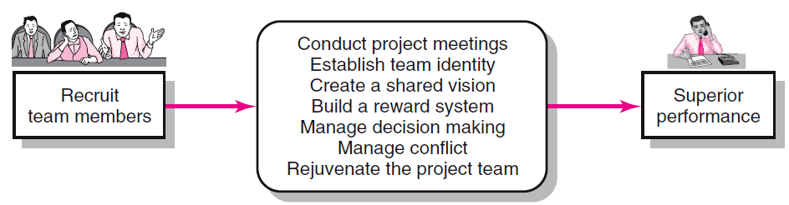
Creating a High-Performance Project Team

Slide 20
Building High-Performance Project Teams
Recruiting Project Members
Factors affecting recruiting
Importance of the project
Management structure used to complete the project
How to recruit?
Ask for volunteers
Who to recruit?
Problem-solving ability
Availability
Technological expertise
Credibility
Political connections
Ambition, initiative, and energy

Slide 21
Project Team Meetings
Managing Subsequent Meetings
Establishing Ground Rules
Conducting Project Meetings
Relationship Decisions
Planning Decisions
Managing Change Decisions
Tracking Decisions

Slide 22
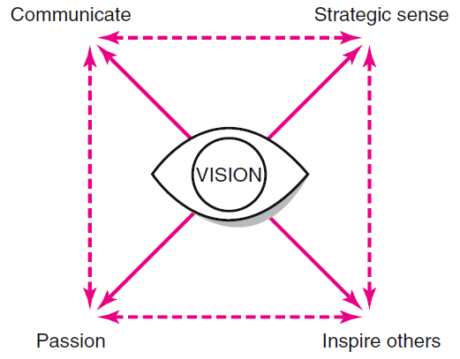
Requirements for an Effective Shared Vision

Slide 23
Managing Project Reward Systems
Group Rewards
Who gets what as an individual reward?
How to make the reward have lasting significance?
How to recognize individual performance?
Letters of commendation
Public recognition for outstanding work
Desirable job assignments
Increased personal flexibility

Slide 24
The Role of the Project Manager
Job descriptions vary, but most include responsibilities like planning, scheduling, coordinating, and working with people to achieve project goals
Remember that 97% of successful projects were led by experienced project managers, who can often help influence success factors

Slide 25
Suggested Skills for Project Managers
The Project Management Body of Knowledge
Application area knowledge, standards, and regulations
Project environment knowledge
General management knowledge and skills
Soft skills or human relations skills

Slide 26
Ten Most Important Skills and Competencies for Project Managers
1. People skills
2. Leadership
3. Listening
4. Integrity, ethical behavior, consistent
5. Strong at building trust
6. Verbal communication
7. Strong at building teams
8. Conflict resolution, conflict management
9. Critical thinking, problem solving
10. Understands, balances priorities

Slide 27
Select a PM in Different Situations
Large projects: Leadership, relevant prior experience, planning, people skills, verbal communication, and team-building skills were most important
High uncertainty projects: Risk management, expectation management, leadership, people skills, and planning skills were most important
Very novel projects: Leadership, people skills, having vision and goals, self confidence, expectations management, and listening skills were most important

Slide 28
The Project Management Institute
The Project Management Institute (PMI) is an international professional society for project managers founded in 1969
PMI has continued to attract and retain members, reporting more than 449,000 members worldwide by late 2014
There are communities of practices in many areas, like information systems, financial services, and health care
Project management research and certification programs continue to grow
Students can join PMI at a reduced fee and earn the Certified Associate in Project Management (CAPM) certification(see www.pmi.org for details)

Slide 29
Project Management Certification
PMI provides certification as a Project Management Professional (PMP)
A PMP has documented sufficient project experience, agreed to follow a code of ethics, and passed the PMP exam
The number of people earning PMP certification is increasing quickly

Slide 30
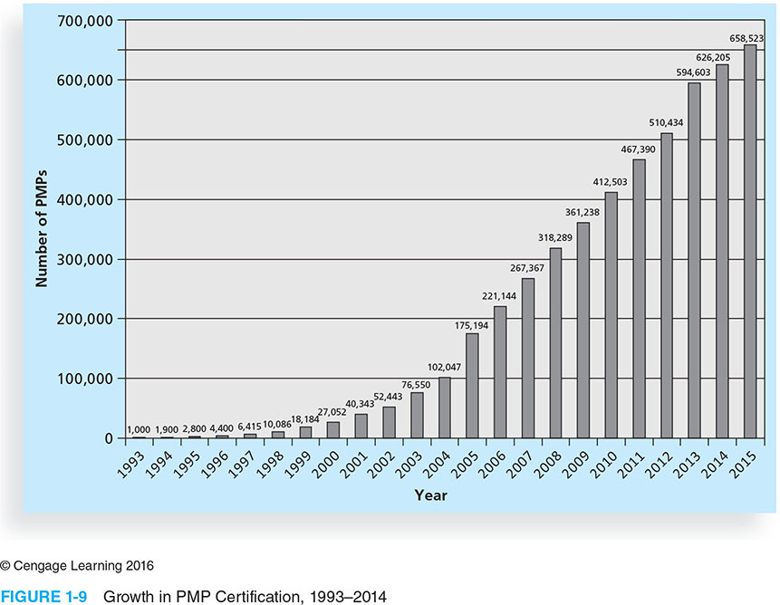
Growth in PMP Certification (1993-2015)

Slide 31
Ethics in Project Management
Ethics, loosely defined, is a set of principles that guide our decision making based on personal values of what is “right” and “wrong”
Project managers often face ethical dilemmas
In order to earn PMP certification, applicants must agree to PMI’s Code of Ethics and Professional Conduct
Several questions on the PMP exam are related to professional responsibility, including ethics

Slide 32
Project Management Software
There are hundreds of different products to assist in performing project management
Three main categories of tools:
Low-end tools: Handle single or smaller projects well, cost under $200 per user
Midrange tools: Handle multiple projects and users, cost $200-$1,000 per user, Project 2013 most popular
High-end tools: Also called enterprise project management software, often licensed on a per-user basis
Several free or open-source tools are also available

Slide 33
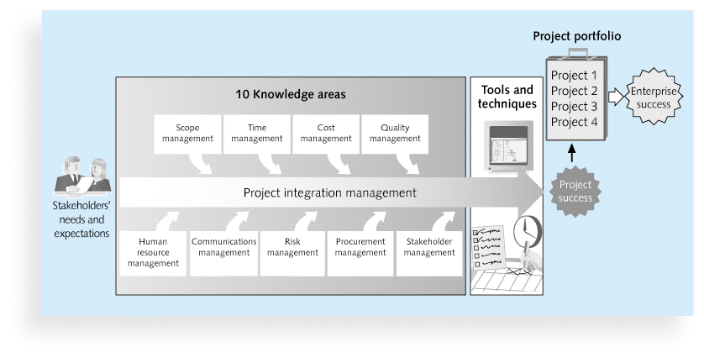
Project Management Framework

Slide 34
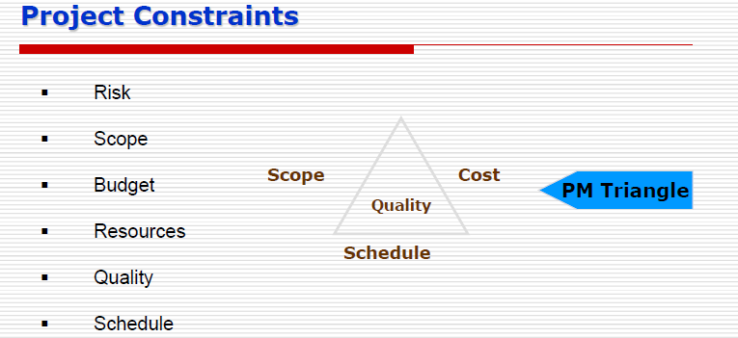

Slide 35
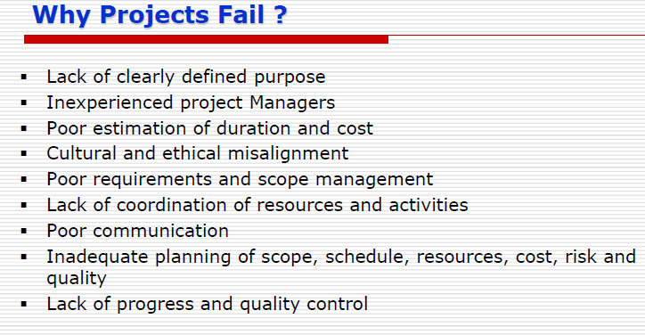

Slide 36
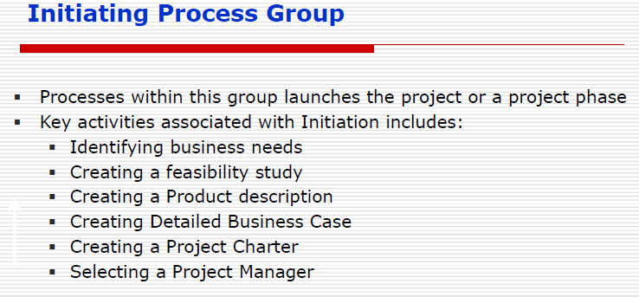

Slide 37
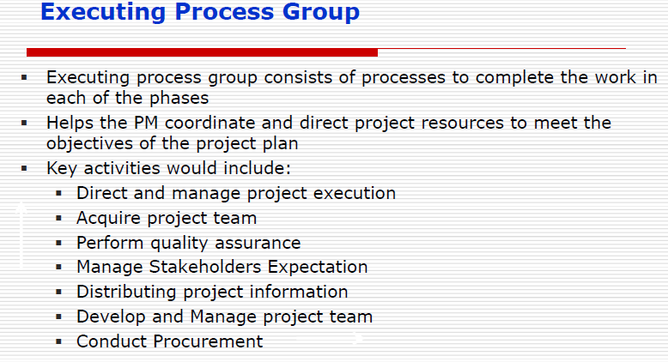

Slide 38
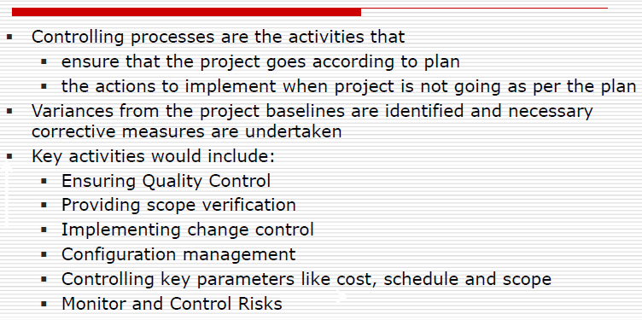
Monitoring and controlling process group

Slide 39
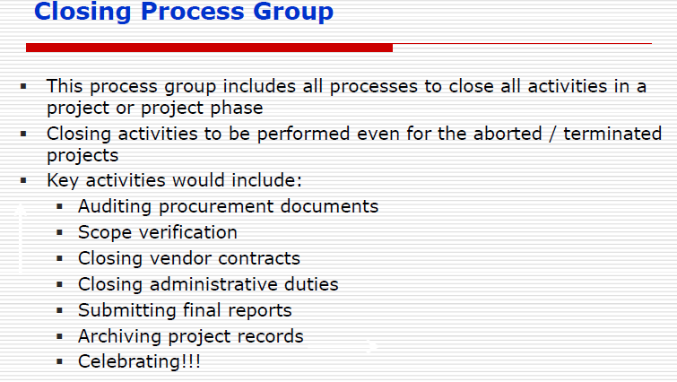

Slide 40
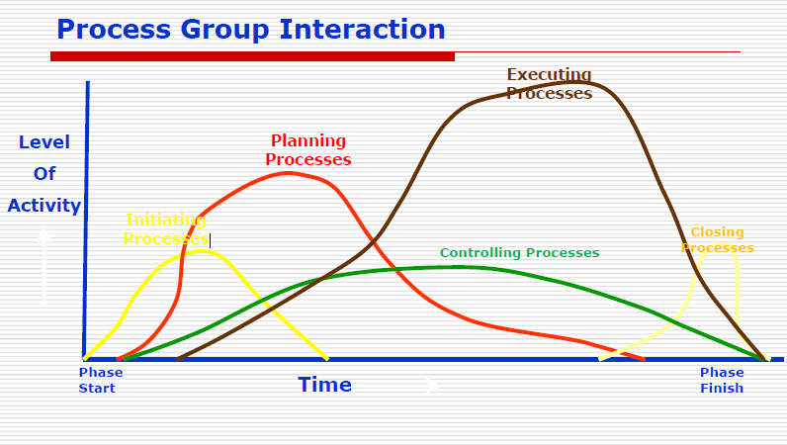

Slide 41
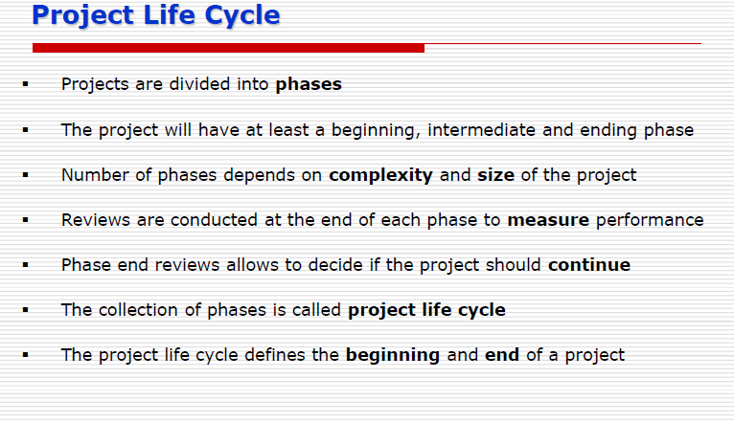

Slide 42
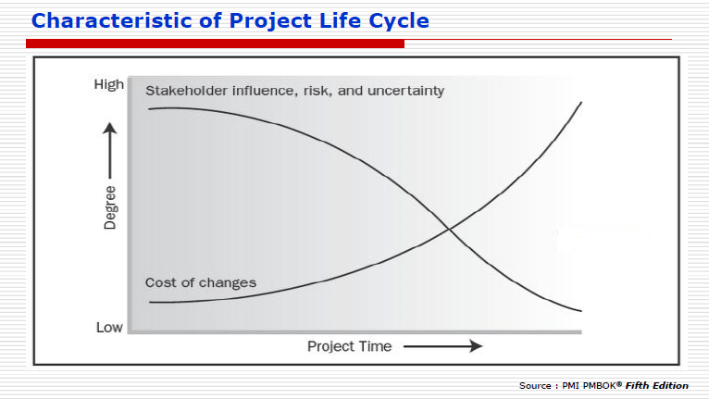

Slide 43
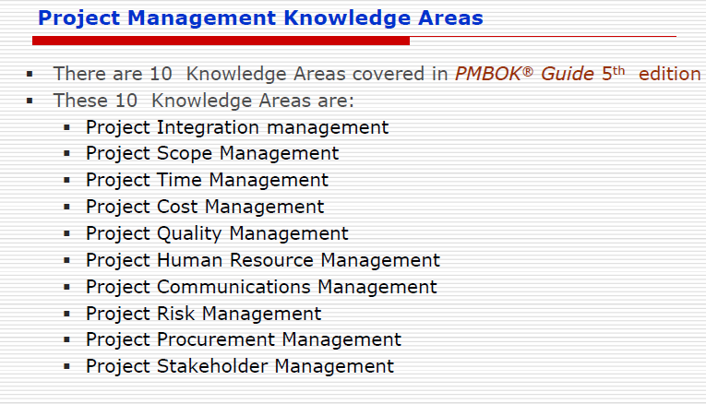

Slide 44
Chapter Summary
A project is a temporary endeavor undertaken to create a unique product, service, or result
Project management is the application of knowledge, skills, tools, and techniques to project activities to meet project requirements
A program is a group of related projects managed in a coordinated way
Project portfolio management involves organizing and managing projects and programs as a portfolio of investments
Project managers play a key role in helping projects and organizations succeed
The project management profession continues to grow and mature

